Slide 1
Artificial Intelligence
Linear Regression
Notes:
Slides and exercises are from Andrew’s Ng course on Machine Learning

Slide 2
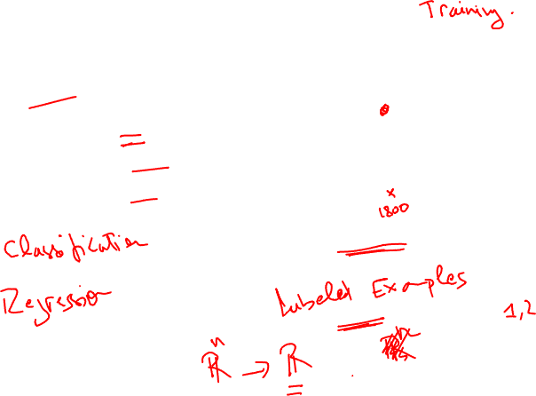
Housing Prices
(Portland, OR)
Price
(in 1000s of dollars)
Size (feet²)
Supervised Learning
Given the “right answer” for each example in the data.
Regression Problem
Predict real-valued output

Slide 3
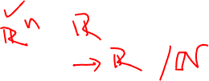
Training set of
housing prices
(Portland, OR)
Size in feet² (x) | Price ($) in 1000's (y)
2104 | 460
1416 | 232
1534 | 315
852 | 178
… | …
Notation:
m = Number of training examples
x’s = “input” variable / features
y’s = “output” variable / “target” variable

Slide 4
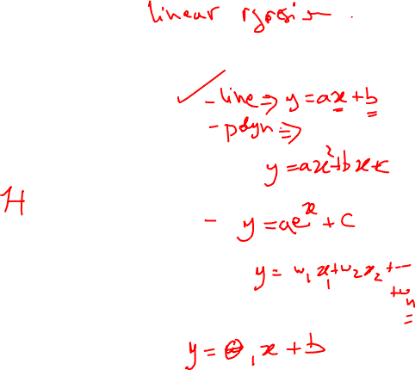
Training Set
How do we represent h ?
Learning Algorithm
Size of house
h
Estimated price
Linear regression with one variable.
Univariate linear regression.

Slide 5
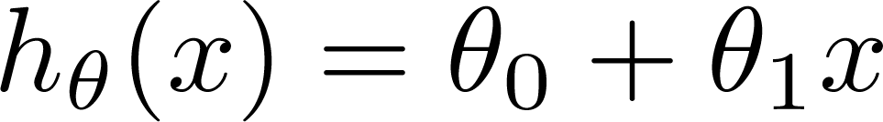

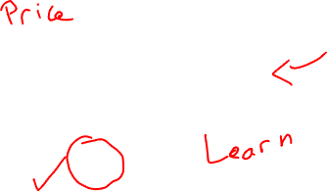
Training Set
Size in feet² (x) | Price ($) in 1000's (y)
2104 | 460
1416 | 232
1534 | 315
852 | 178
… | …
Hypothesis:
‘s: Parameters
How to choose ‘s ?

Slide 6
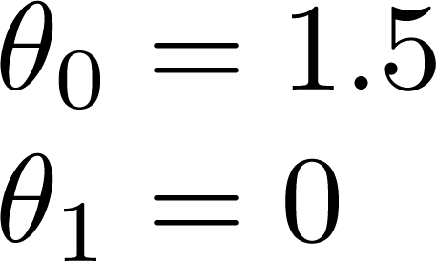
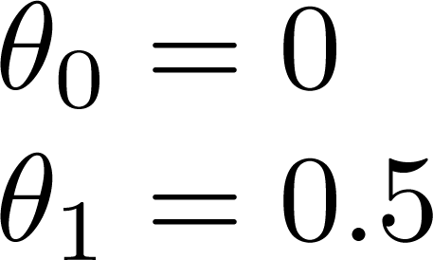
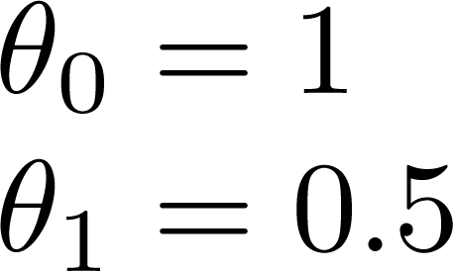
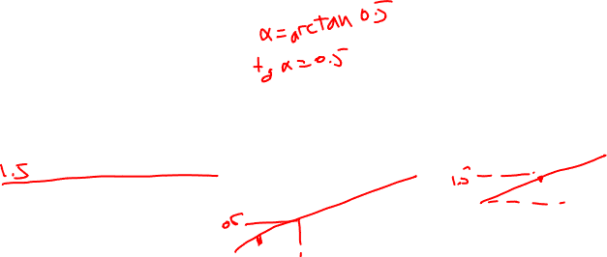

Slide 7
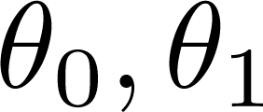


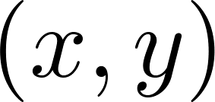
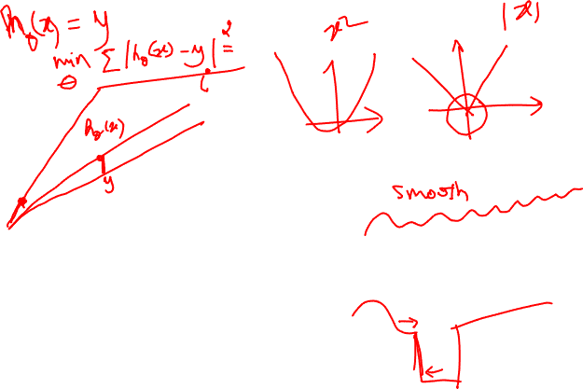
y
x
Idea: Choose so that is close to for our training examples

Slide 8
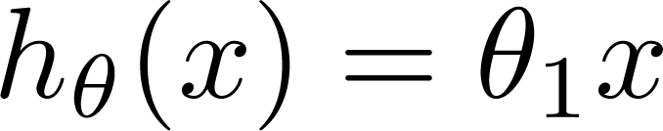

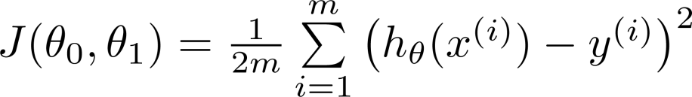
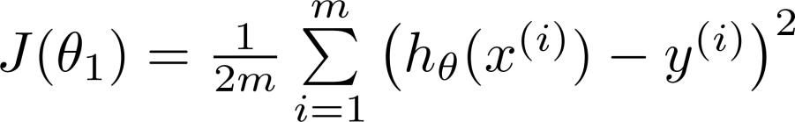
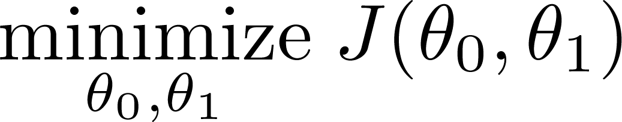
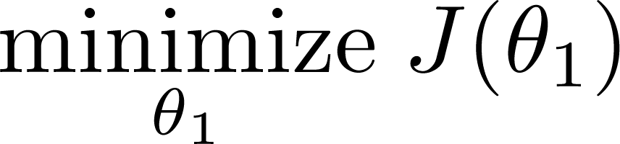
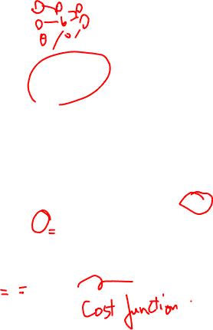
Simplified
Hypothesis:
Parameters:
Cost Function:
Goal:

Slide 9





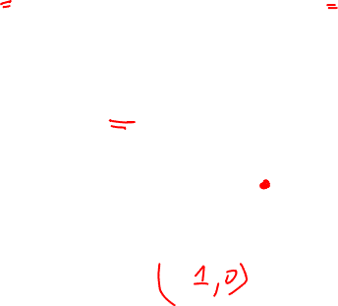
(for fixed , this is a function of x)
(function of the parameter )
y
x

Slide 10

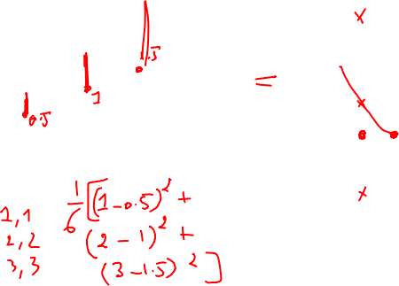
(for fixed , this is a function of x)
(function of the parameter )
y
x

Slide 11

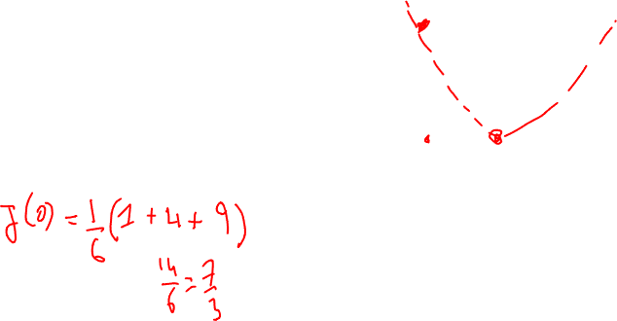
(for fixed , this is a function of x)
(function of the parameter )
y
x

Slide 12
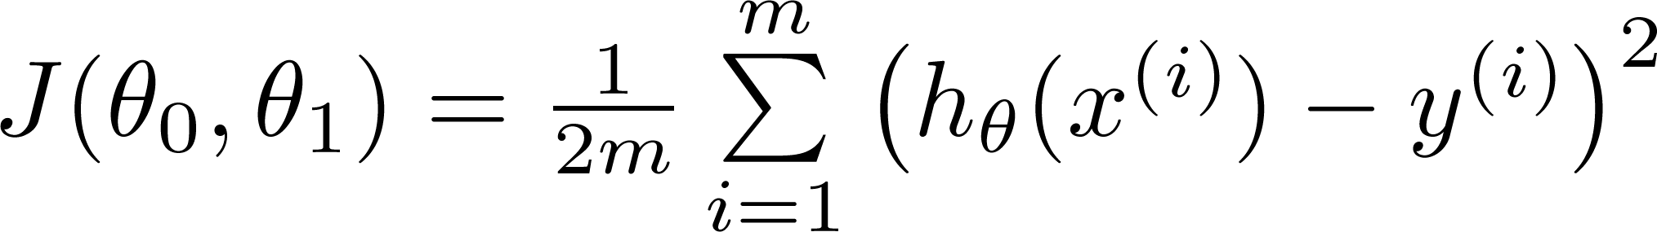
Hypothesis:
Parameters:
Cost Function:
Goal:

Slide 13
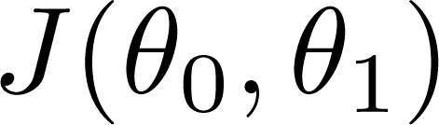


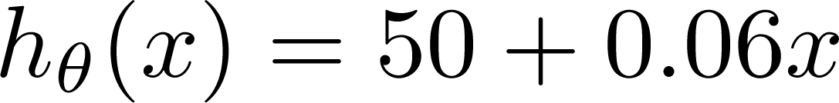
(for fixed , this is a function of x)
(function of the parameters )
Price ($)
in 1000’s
Size in feet² (x)

Slide 14
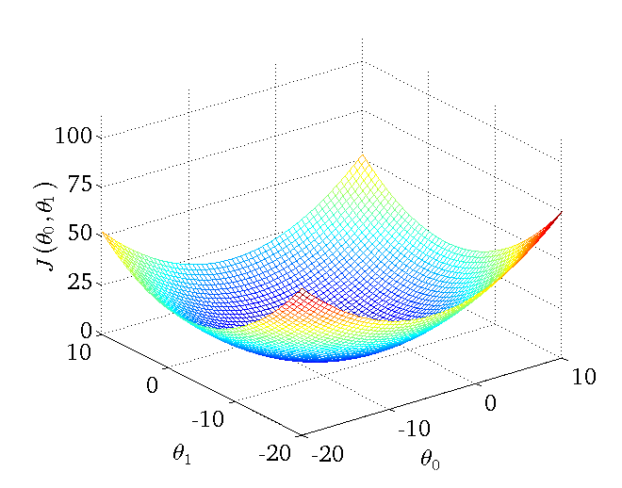
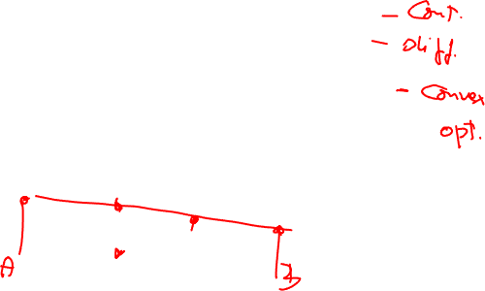

Slide 15
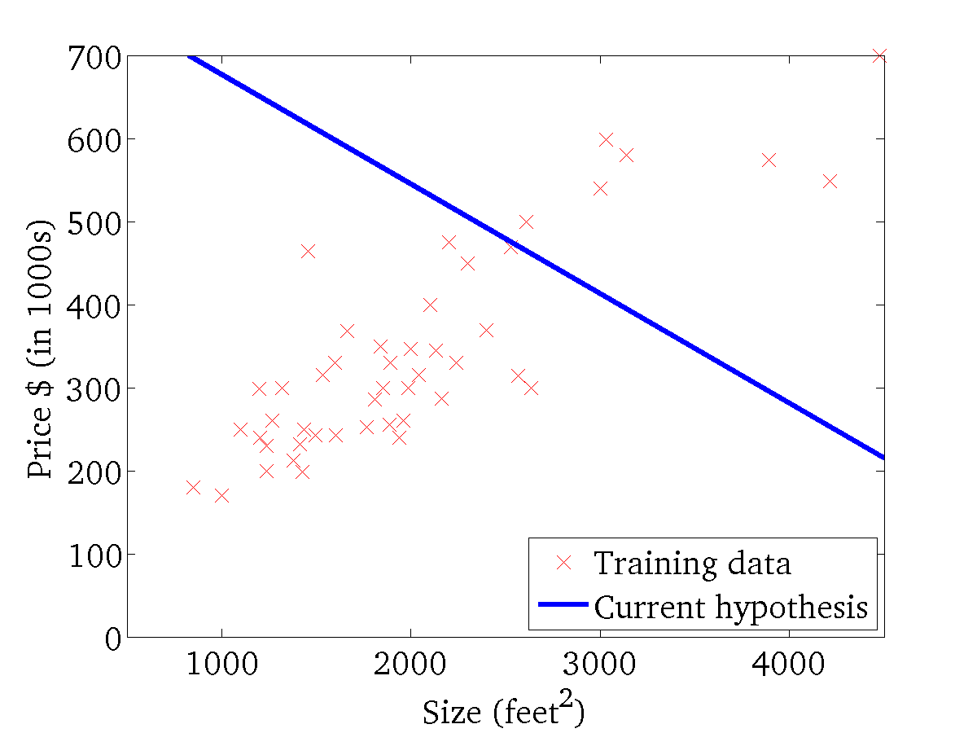
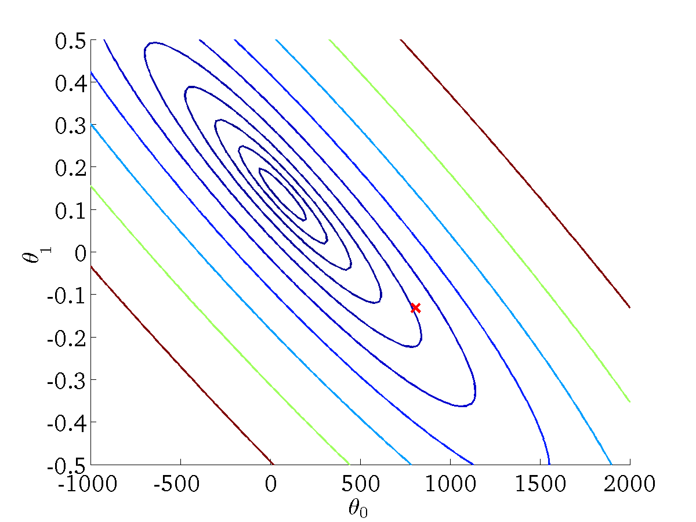
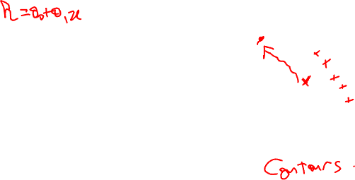
(for fixed , this is a function of x)
(function of the parameters )

Slide 16
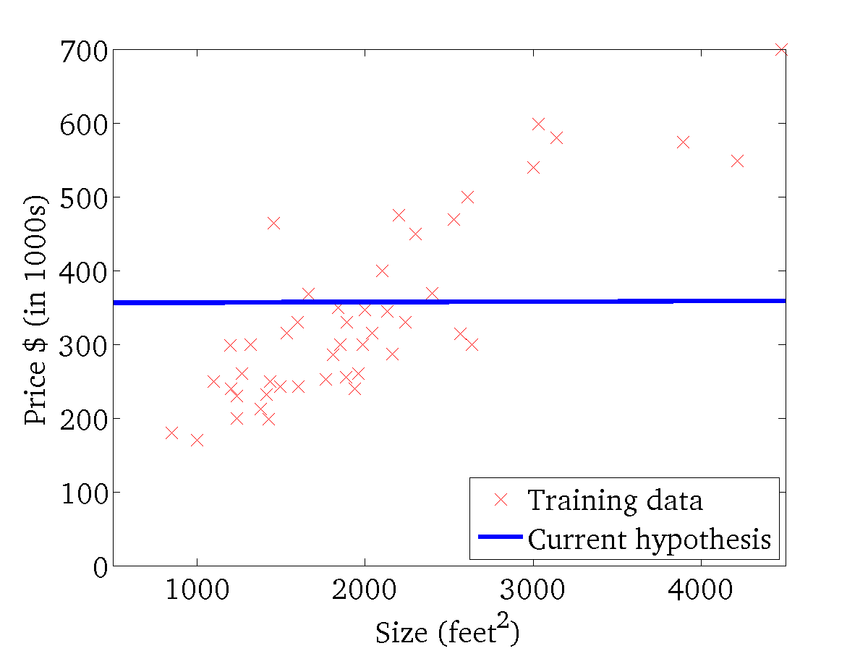
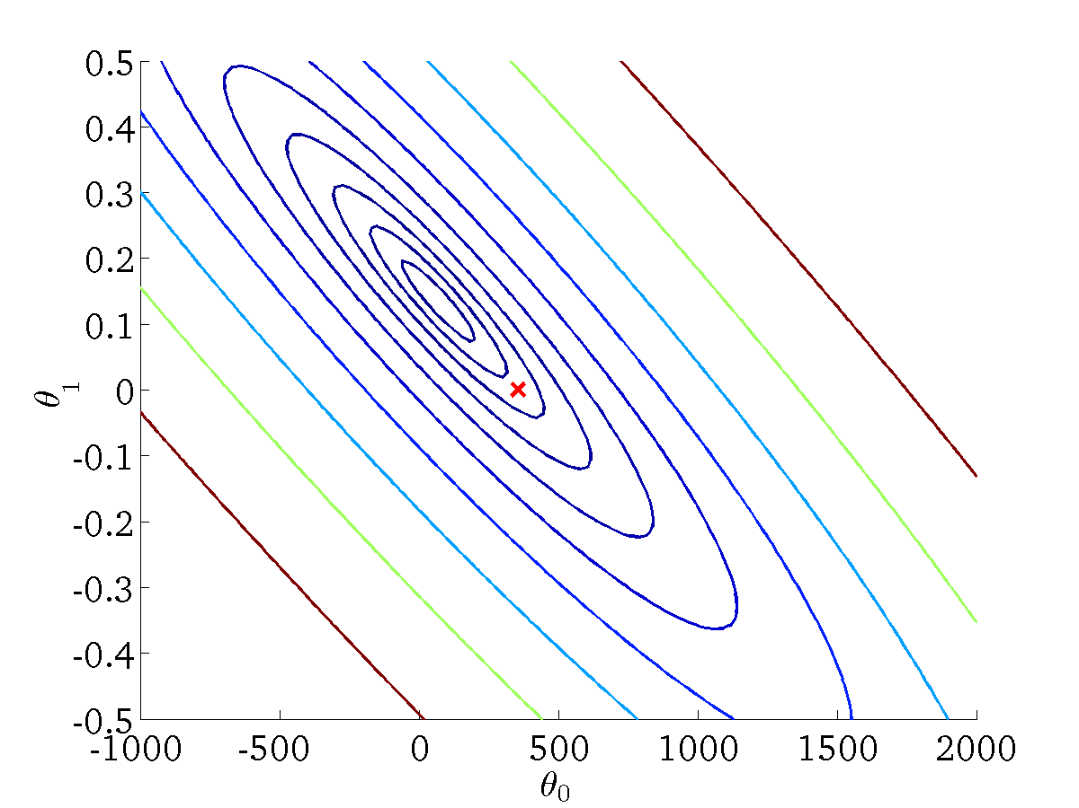
(for fixed , this is a function of x)
(function of the parameters )

Slide 17
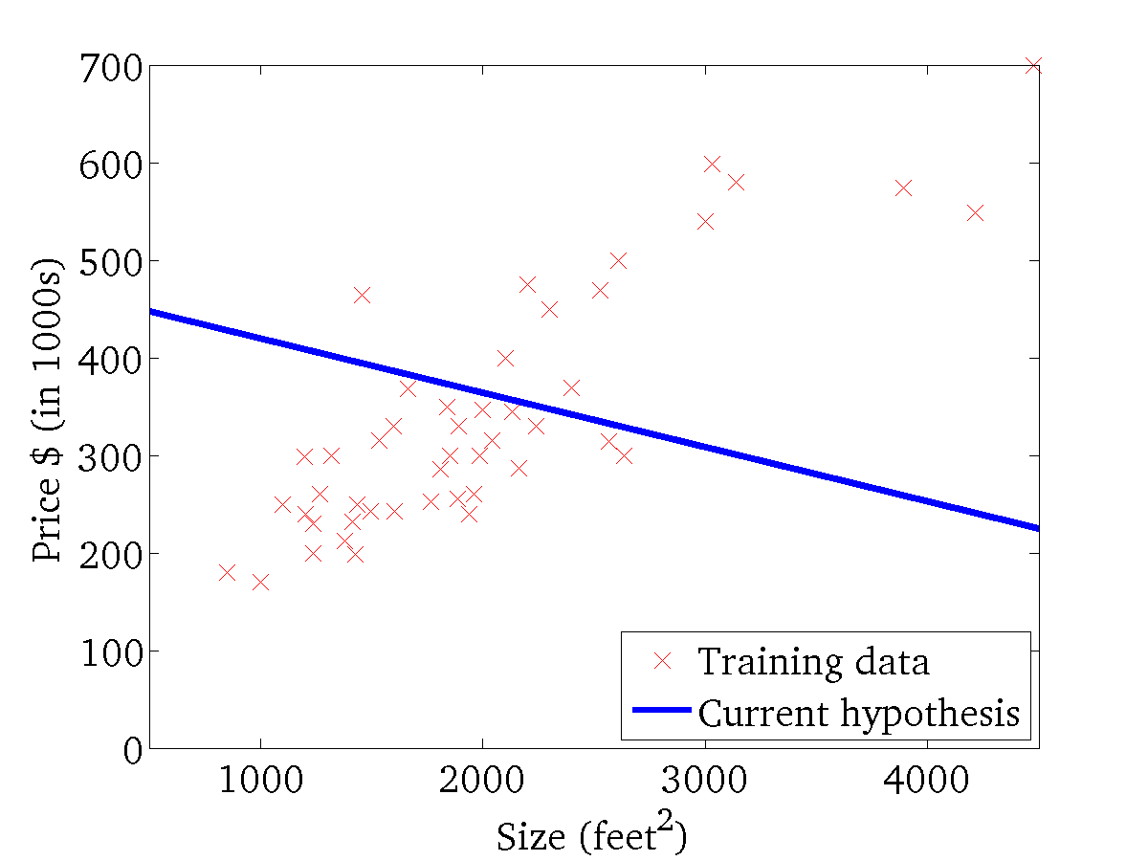

(for fixed , this is a function of x)
(function of the parameters )

Slide 18
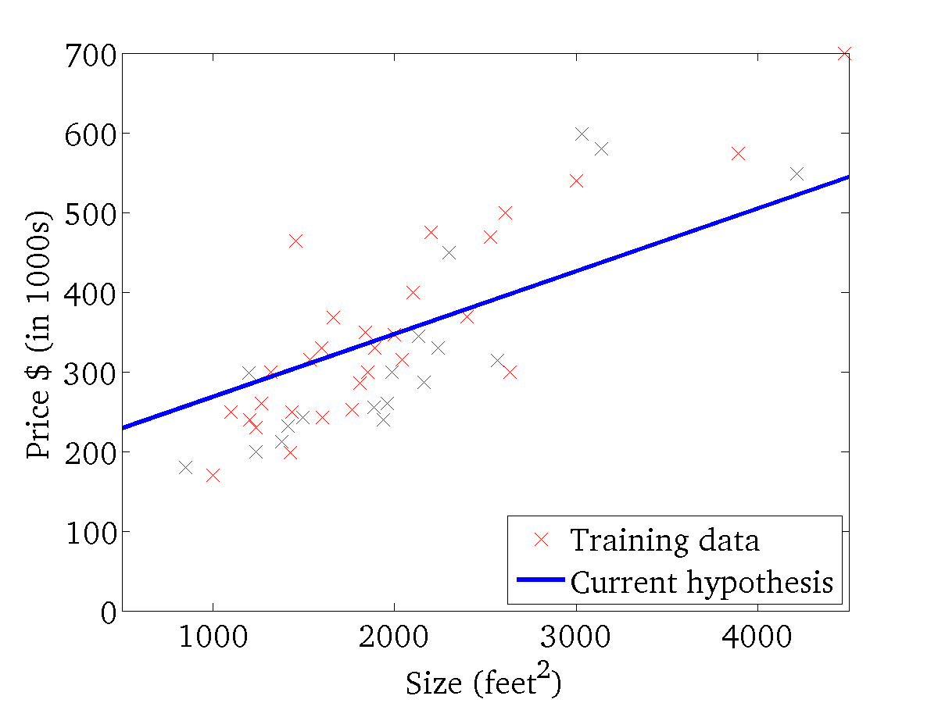
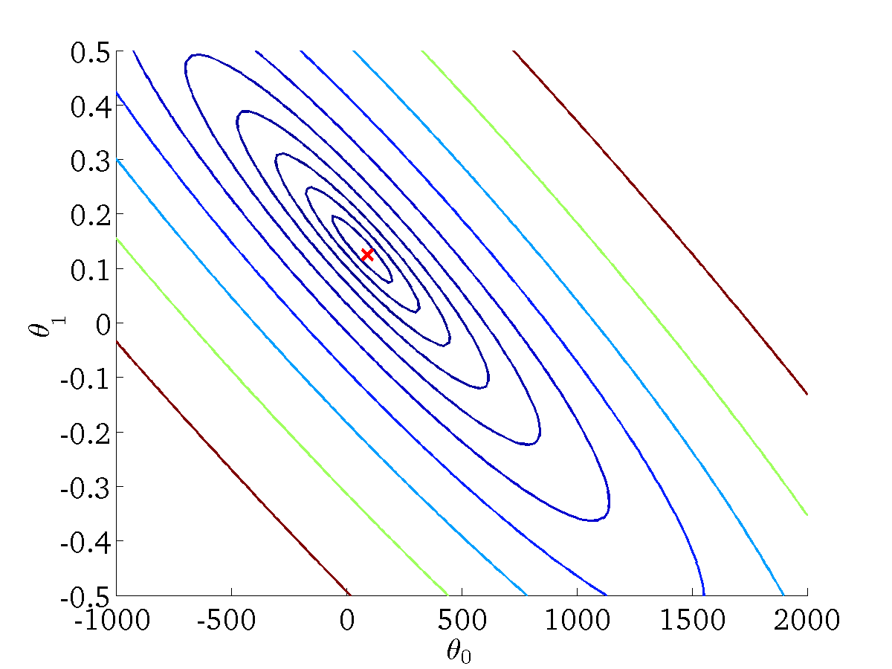
(for fixed , this is a function of x)
(function of the parameters )

Slide 19
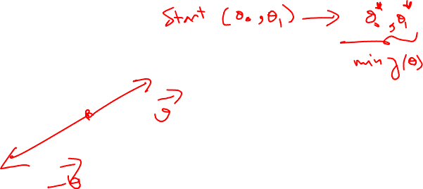
Gradient Descent

Slide 20
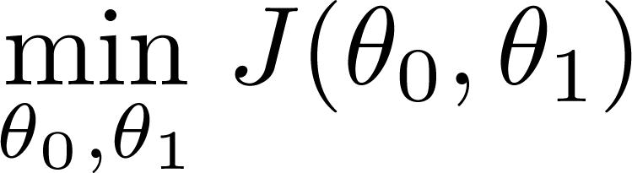
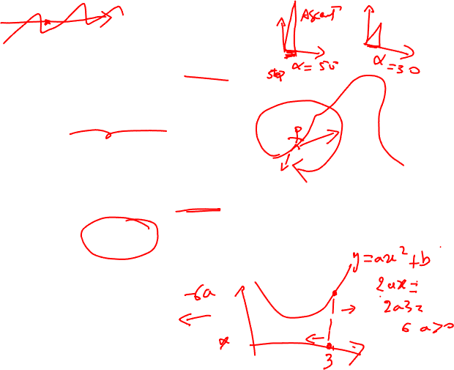
Have some function
Want
Outline:
Start with some
Keep changing to reduce until we hopefully end up at a minimum

Slide 21
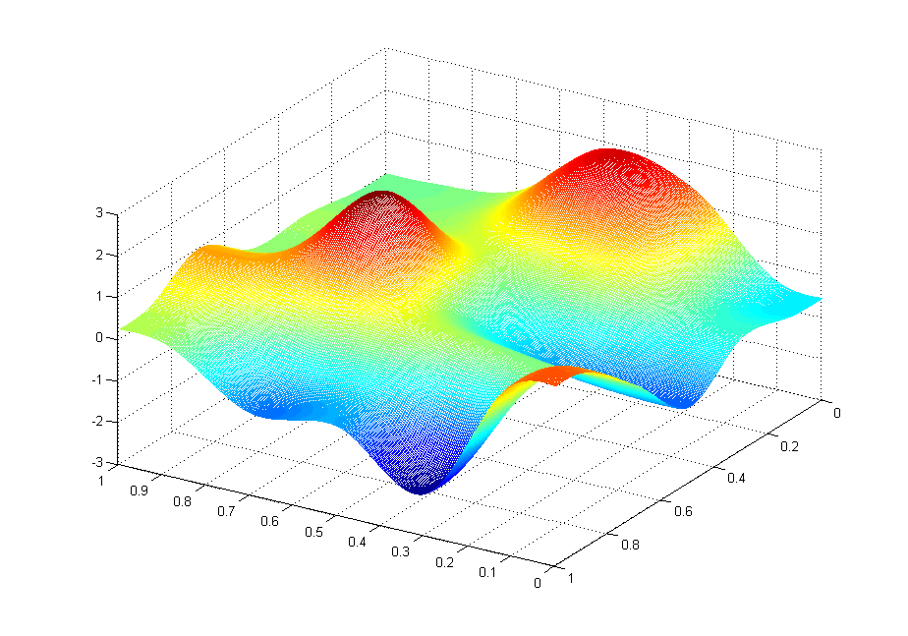
J(θ₀,θ₁)
θ₁
θ₀

Slide 22
J(θ₀,θ₁)
θ₁
θ₀

Slide 23
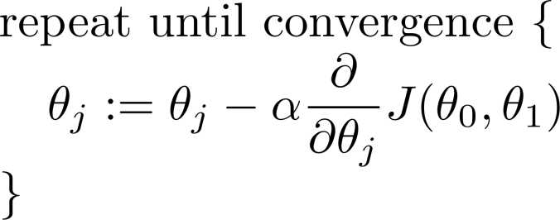
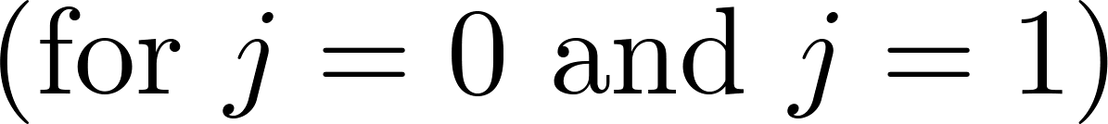
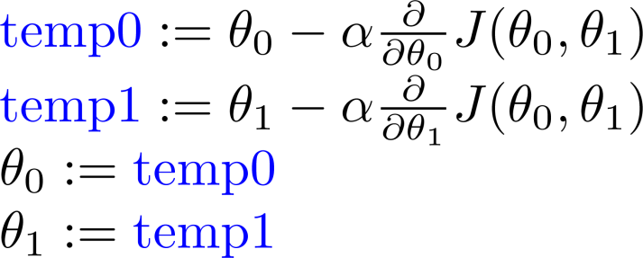
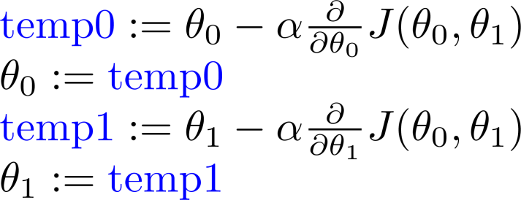
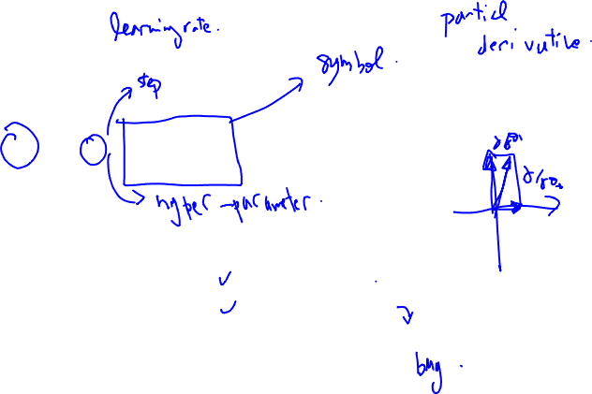
Gradient descent algorithm
Correct: Simultaneous update
Incorrect:

Slide 25
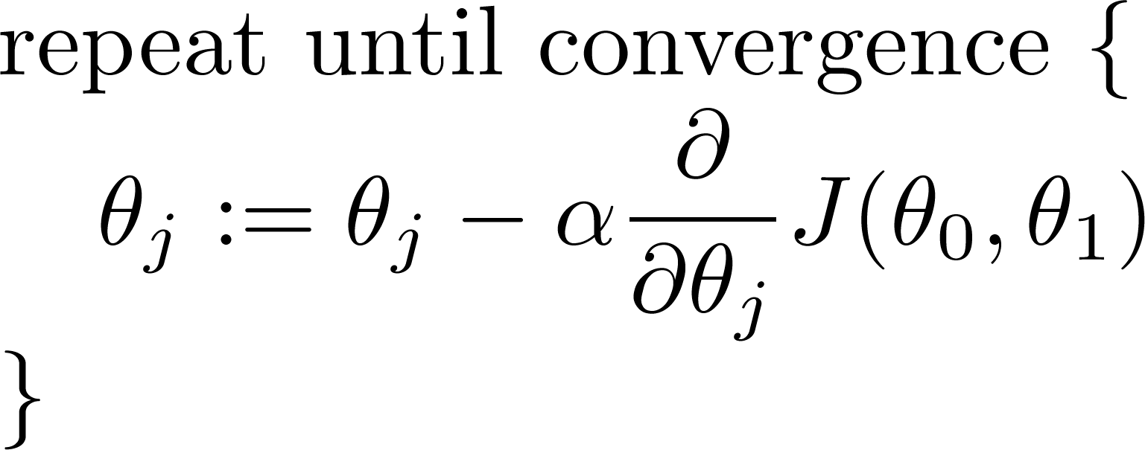
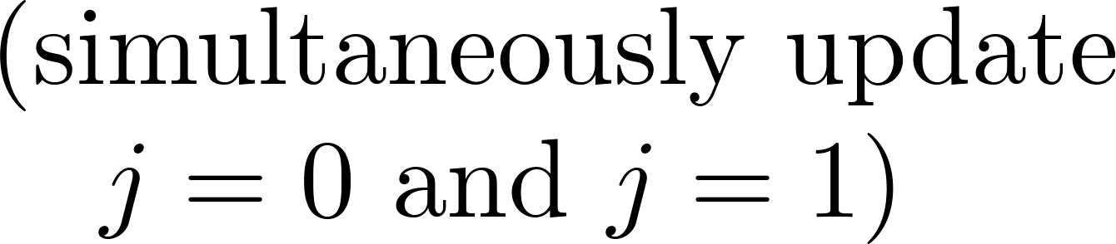
Gradient descent algorithm

Slide 27
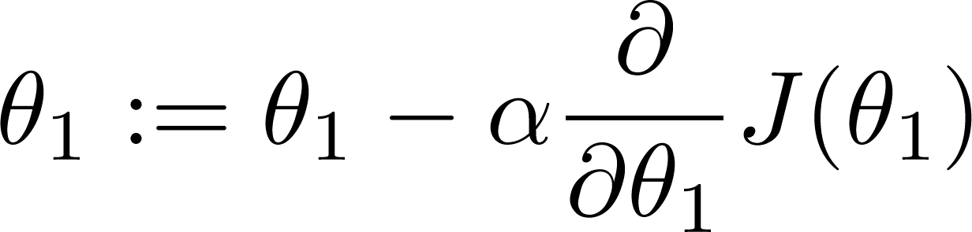
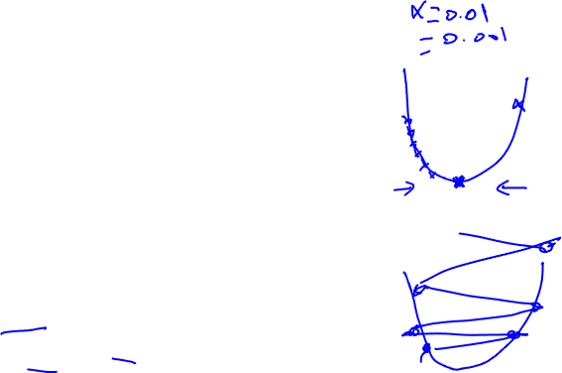
If α is too small, gradient descent can be slow.
If α is too large, gradient descent can overshoot the minimum. It may fail to converge, or even diverge.

Slide 28

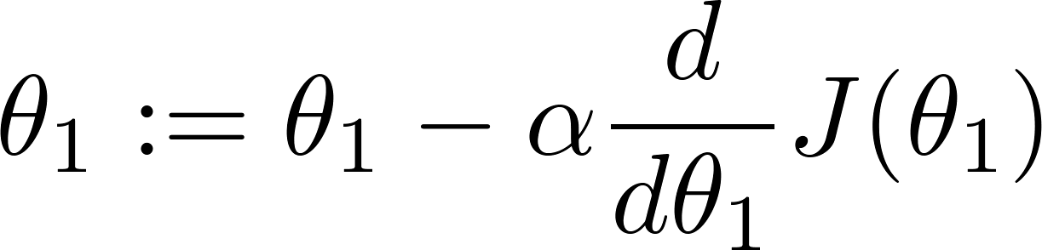
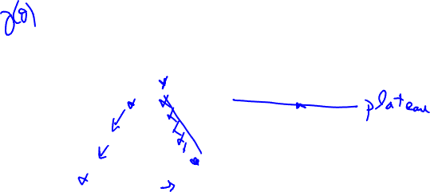
at local optima
Current value of

Slide 29
Gradient descent can converge to a local minimum, even with the learning rate α fixed.
As we approach a local minimum, gradient descent will automatically take smaller steps. So, no need to decrease α over time.

Slide 31
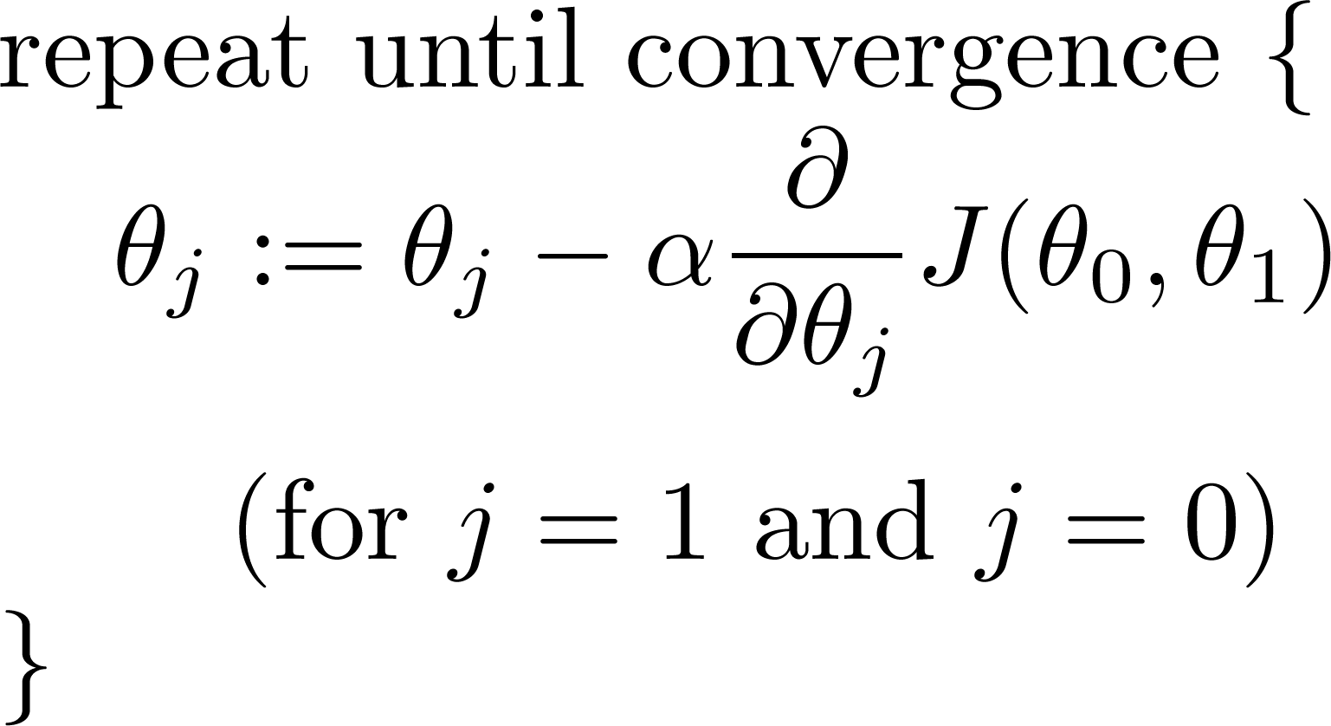

Gradient descent algorithm
Linear Regression Model

Slide 32






Slide 33



Gradient descent algorithm
update
and
simultaneously

Slide 34
J(θ₀,θ₁)
θ₁
θ₀

Slide 35
J(θ₀,θ₁)
θ₁
θ₀

Slide 37


(for fixed , this is a function of x)
(function of the parameters )

Slide 38

(for fixed , this is a function of x)
(function of the parameters )

Slide 39


(for fixed , this is a function of x)
(function of the parameters )

Slide 40


(for fixed , this is a function of x)
(function of the parameters )

Slide 41

(for fixed , this is a function of x)
(function of the parameters )

Slide 42

(for fixed , this is a function of x)
(function of the parameters )

Slide 43


(for fixed , this is a function of x)
(function of the parameters )

Slide 44

(for fixed , this is a function of x)
(function of the parameters )

Slide 45



(for fixed , this is a function of x)
(function of the parameters )

Slide 46
“Batch” Gradient Descent
“Batch”: Each step of gradient descent uses all the training examples.

